Slide 1
CptS 327
Symmetric Key Cryptosystems
Notes:
Template-WSU Hrz 201.ppt

Slide 2
Today’s Topics
Overview
  AES
    ECB
    CBC
  RC4
Notes:
Template-WSU Hrz 201.ppt

Slide 3
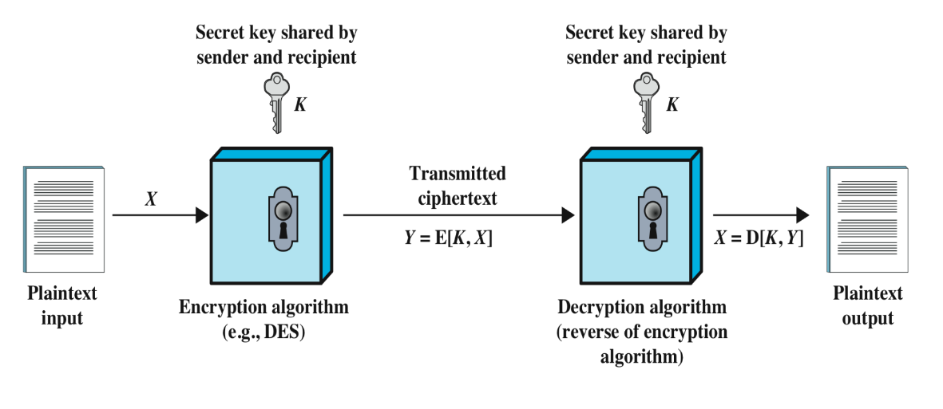
Symmetric Approach
Notes:
Template-WSU Hrz 201.ppt

Slide 4
Symmetric Key Approaches
Block ciphers
  Break text into blocks, encrypt each block
  Key: random string of bits (56 < k < 512)
  Examples: DES, 3DES, AES
Stream ciphers
  Encrypts text as a continuous stream
  Keystream: random stream of data; one-time use
    same length as plaintext
  XOR plain with keystream to get cipher
  XOR cipher with keystream to get plain
Notes:
Template-WSU Hrz 201.ppt

Slide 5
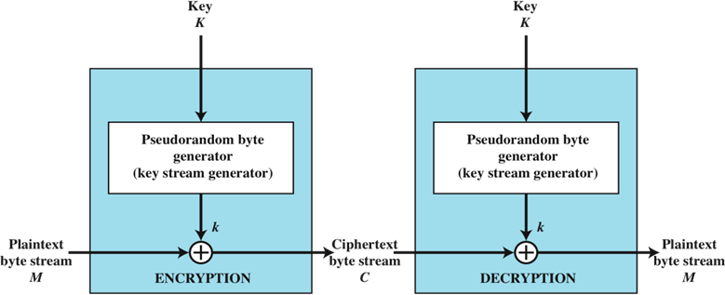
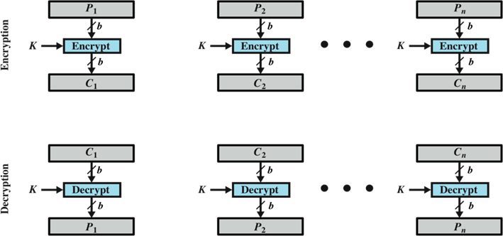
Symmetric Key Approaches
Stream ciphers are harder to use since unique keystreams are difficult to produce as a keystream can never be reused
Block ciphers are slower than stream ciphers
Notes:
Template-WSU Hrz 201.ppt

Slide 6
Advanced Encryption Standard (AES)
Developed by Joan Daemen and Nicent Rijmen
Replaces DES / 3DES
Relatively better security than DES
Encryption of blocks via ‘rounds’
  # of ‘rounds’ depends on primary key sizes
    128bit key = 10 rounds
    192bit key = 12 rounds
    256bit key = 14 rounds
    512bit key = 22 rounds
Notes:
Template-WSU Hrz 201.ppt

Slide 7
Advanced Encryption Standard (AES)
Each round is a series of: substitution, shifting, permutation, and adding round key
Round key is a derivation of the primary key
  E.g. 128bit pkey has 11 round keys (128bits each)
Computing round keys from primary key is called ‘expanding the key’
Notes:
Template-WSU Hrz 201.ppt

Slide 8
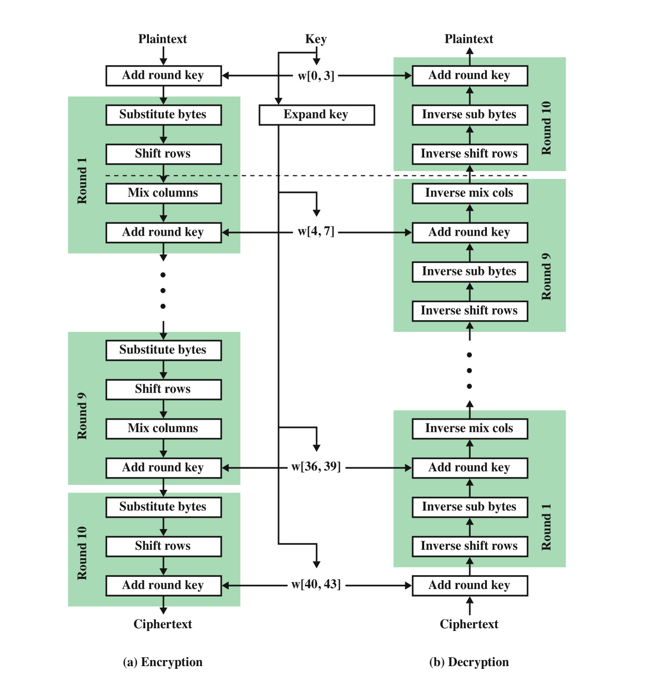
Advanced Encryption Standard (AES)
Notes:
Template-WSU Hrz 201.ppt

Slide 9
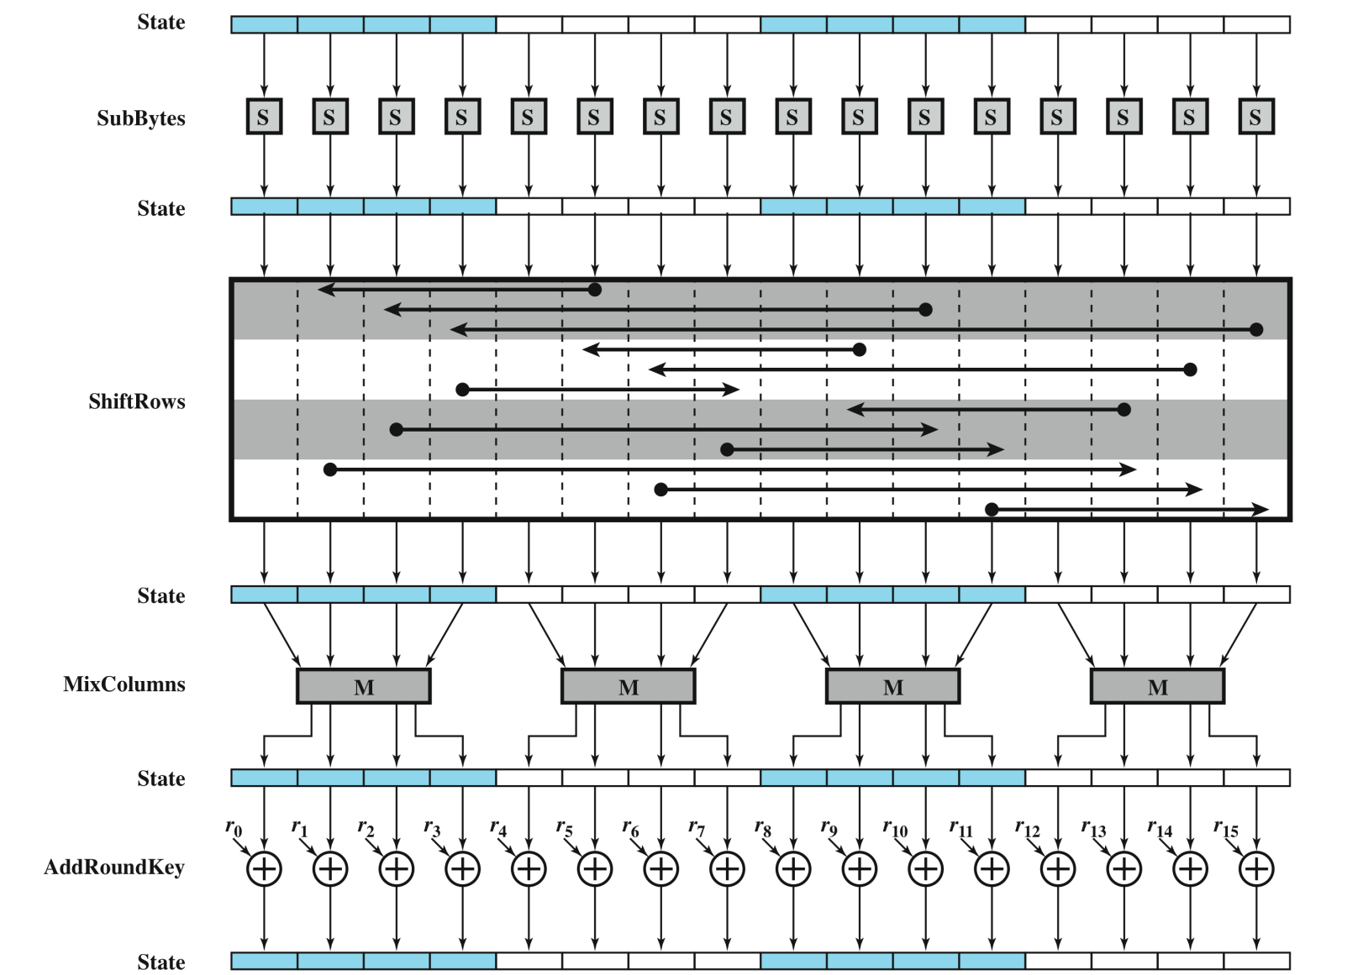
Single AES Round
Notes:
Template-WSU Hrz 201.ppt

Slide 10
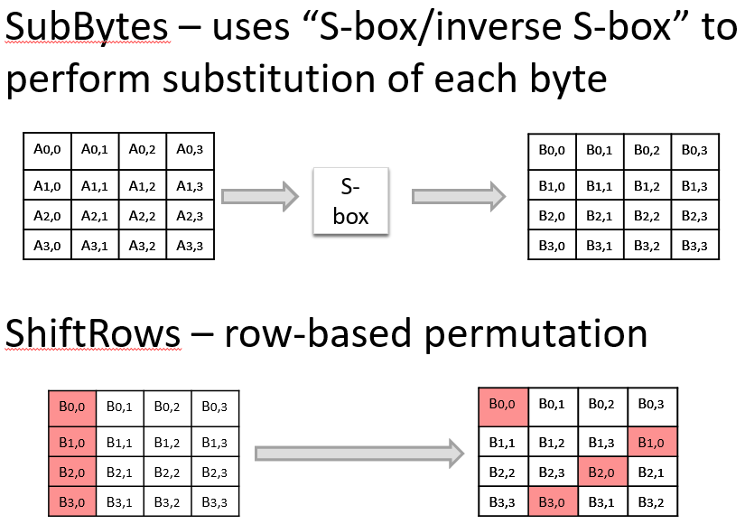
AES Rounds
Notes:
Template-WSU Hrz 201.ppt

Slide 11
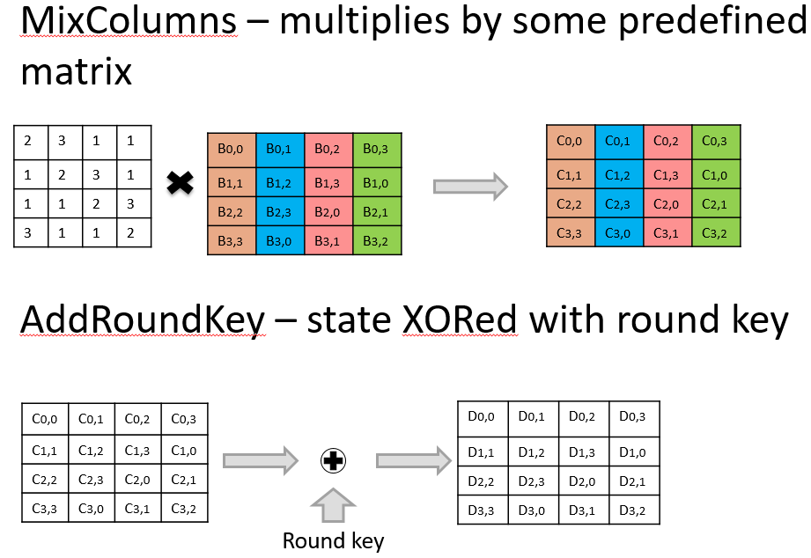
AES Rounds
Notes:
Template-WSU Hrz 201.ppt

Slide 12
Single AES Round
Notes:
Template-WSU Hrz 201.ppt

Slide 13
Advanced Encryption Standard (AES)
Notes:
Template-WSU Hrz 201.ppt

Slide 14
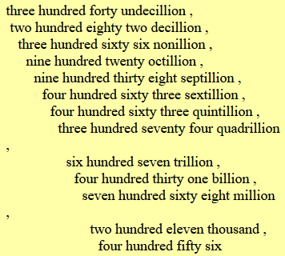
Security of AES
Avg. key length 128bits i.e. 2^128 possible keys
2^128: 340,282,366,920,938,463,463,374,607,431,768,211,456
Assuming following
  Modern GPU’s avg processing power: 33,862,700 bits/s ~ (3.4 x 10^16) b/s
  Assume 1000 operations per decryption
    ~(1.1 x 10^21) decryptions/year
    Time taken to crack 128bit AES encryption (2^128)/(1.1 x 10^21)
      ~(3.1 x 10^17) years
AES 128 may work for a lay person
AES 256 may work for top secret national security info
Notes:
Template-WSU Hrz 201.ppt

Slide 15
AES Modes of Operation
The algorithm we saw is for one block
How do we manage all the blocks?
Depends on modes of operations
  Defines
    size of blocks
    sequence of blocks
AES modes of operation
  Electronic Codebook (ECB)
  Cipher Block Chaining (CBC)
Notes:
Template-WSU Hrz 201.ppt

Slide 16
Electronic Codebook (ECB)
No interdependence between blocks
Each block encrypted/decrypted separately
Individual blocks are treated as messages on their own
Notes:
Template-WSU Hrz 201.ppt

Slide 17


ECB Drawbacks
If there exists a pattern in plaintext, the cipher will retain that pattern
Notes:
Template-WSU Hrz 201.ppt

Slide 18
Cipher Block Chaining
Encryption
  Output of block ‘n’ is XORed with cipher of block ‘n-1’, resulting in cipher for block ‘n’.
  First block uses initialization vector (IV) for XOR
    IV: random nonce
  C₀ = E (K, (IV XOR P₀))
  C_{i} = E (K, (C_{(i-1)} XOR P_{i}))
Decryption
  Inverse of encryption
  C₀ = IV XOR D(K, C₀)
  P_{i} = C_{(i-1)} XOR D(K, C_{i})
Notes:
Template-WSU Hrz 201.ppt

Slide 19
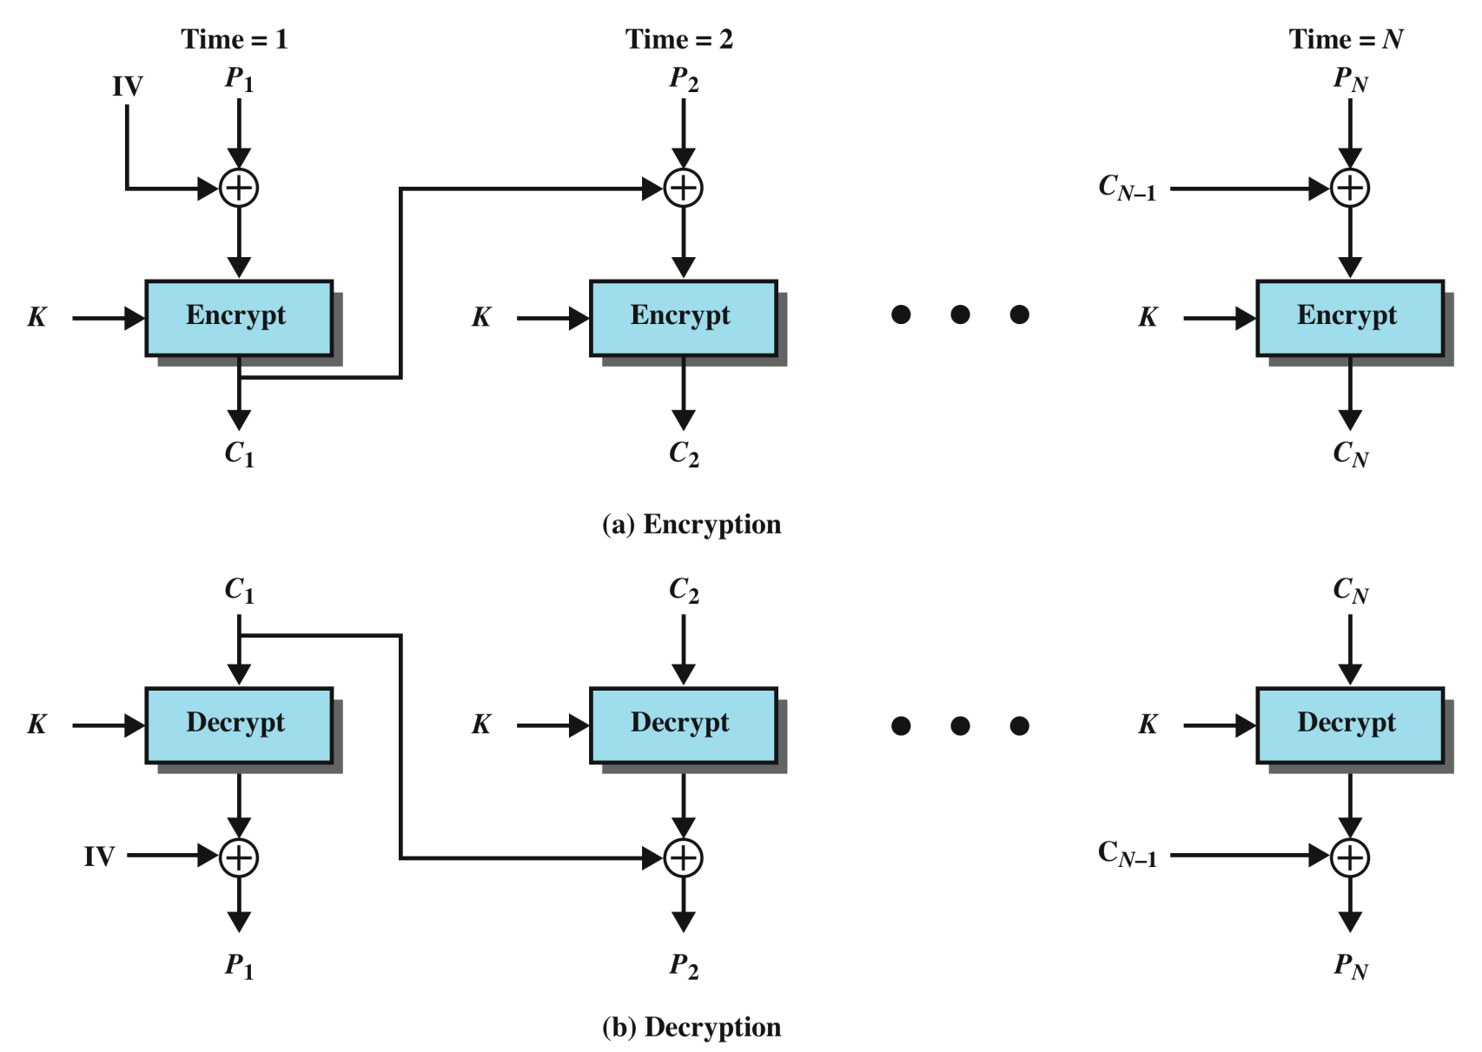
Cipher Block Chaining
Notes:
Template-WSU Hrz 201.ppt

Slide 20

Cipher Block Chaining
Notes:
Template-WSU Hrz 201.ppt

Slide 21
RC4
Popular stream cipher
Developed by Ron Rivest
Keystream: 128bits RNG
Fast; used in TLS/SSL implementations
Broken in 2013 as keystream is not random enough
  http://blog.cryptographyengineering.com/2013/03/attack-of-week-rc4-is-kind-of-broken-in.html
WEP for wireless is based on RC4
Notes:
Template-WSU Hrz 201.ppt

Slide 22
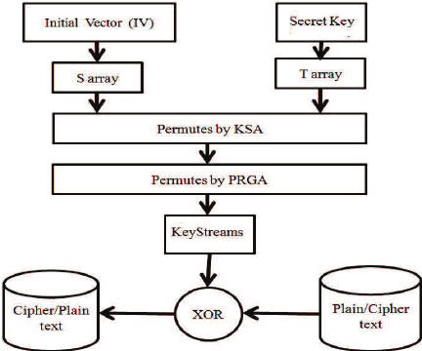
RC4
Notes:
Template-WSU Hrz 201.ppt

Slide 23
Next lecture
Asymmetric Key cryptosystems
Notes:
Template-WSU Hrz 201.ppt

Slide 24
Any questions?
Notes:
Template-WSU Hrz 201.ppt

